Slide 1
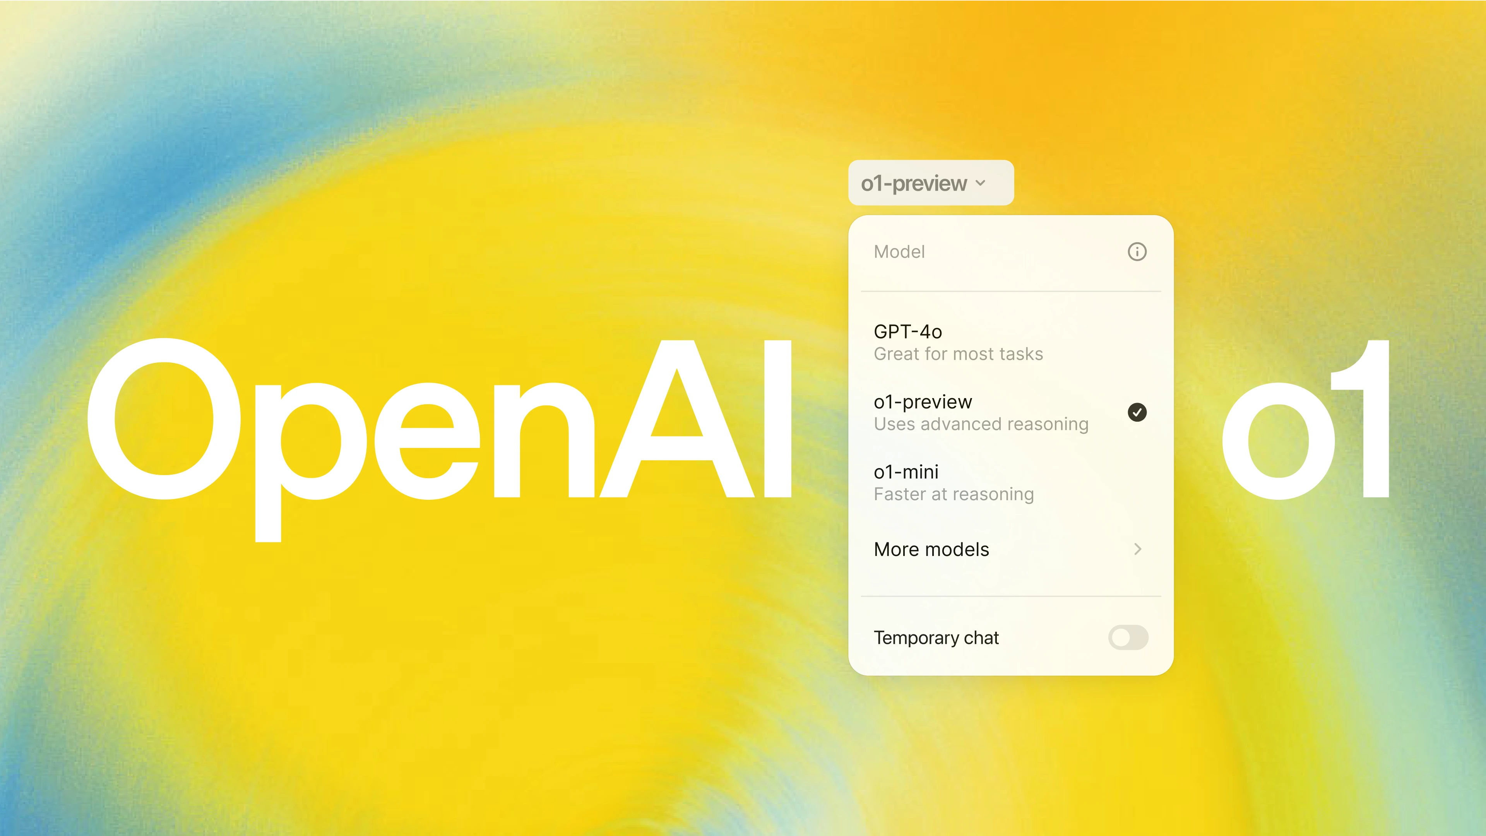


Slide 2
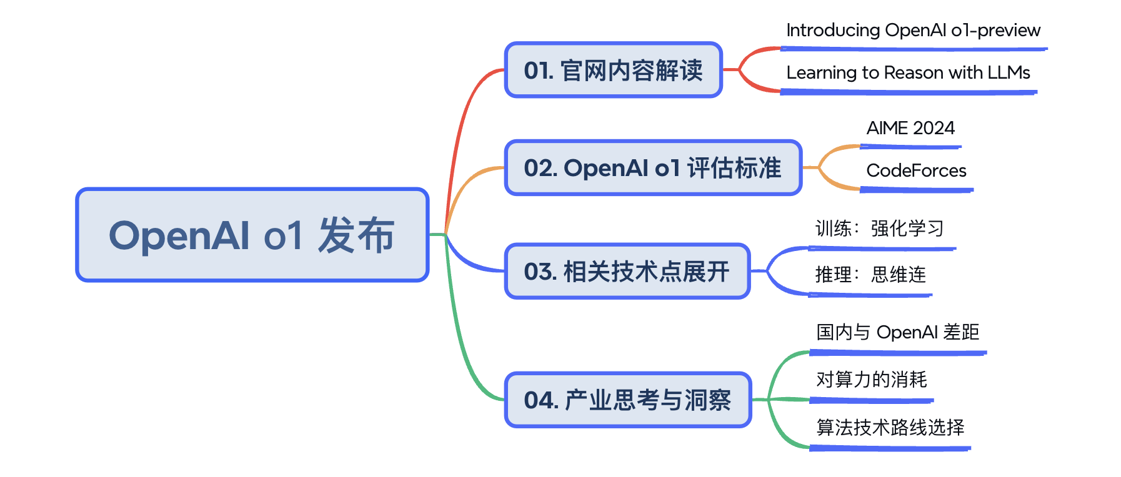
视频内容

Slide 3
01
OpenAI o1
官网解读

Slide 4
官网链接
https://openai.com/o1/
https://openai.com/index/introducing-openai-o1-preview/
https://openai.com/index/openai-o1-mini-advancing-cost-efficient-reasoning/
https://openai.com/index/learning-to-reason-with-llms/

Slide 5
02
OpenAI o1
评估标准

Slide 6
AIME 2024

Slide 7
CodeForces

Slide 8
03
强化学习 RL
思维链 CoT

Slide 9
强化学习 Reinforcement Learning
ChatGPT：RLHF
LLAMA3.1：DPO
STaR：self-Taught Reasoner To Quite STaR

Slide 10
思维连 Chain-of-Thought

Slide 11
04
产业思考与洞察

Slide 12
与 OpenAI 的差距
xxxx

Slide 13
对算力的消耗的预测
xxxx

Slide 14
算法技术路线的选择
xxxx

